Slide 1
Network Virtualization
Lecturer: Shan-Hsiang Shen

Slide 2
About this Course
New network technologies: SDN, NFV, P4, Network Slicing
Introduce some flatforms for the new network technologies
Lecturer: Shan-Hsiang Shen
Email: sshen@csie.ntust.edu.tw
Room: TR-617
Time: Thu. 2,3,4

Slide 3
About this Course
Textbook: no textbook
Website: http://moodle.ntust.edu.tw
Project proposal (20%)
Labs (20%)
Final presentation (30%)
Final report (30%)

Slide 4
Project
Team work
3~5 people per team
Send me your team name and members by Oct. 8
Proposal
About the topic your group want to work on

Slide 5
Project
Final
Make a oral presentation
Hand in a final report

Slide 6
Software-Defined Networking

Slide 7
Recall: per-router control plane
Individual routing algorithm components in each and every router interact with each other in control plane to compute forwarding tables
Routing
Algorithm
control
plane
data
plane

Slide 8
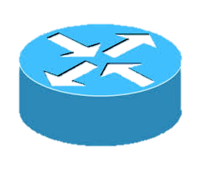
Routing in Traditional Networks
How to deliver packets to another side of a network?

Slide 9
Routing in Traditional Networks
Nodes exchange network conditions

Slide 10
Routing in Traditional Networks
Nodes exchange network conditions
Pick up a route with less cost

Slide 11

Traffic engineering: difficult traditional routing
5
3
v
w
5
2
u
2
1
z
3
1
2
x
y
1
Q: what if network operator wants u-to-z traffic to flow along uvwz, x-to-z traffic to flow xwyz?
A: need to define link weights so traffic routing algorithm computes routes accordingly (or need a new routing algorithm)!
Link weights are only control “knobs”: wrong!
Notes:
Note: implicit assumption here: destination based forwarding

Slide 12
Traffic engineering: difficult
5
3
v
w
5
2
u
2
1
z
3
1
2
x
y
1
Q: what if network operator wants to split u-to-z traffic along uvwz and uxyz (load balancing)?
A: can’t do it (or need a new routing algorithm)
Notes:
Note: implicit assumption here: destination based forwarding

Slide 13

Traffic engineering: difficult
Networking 401
5
v
3
w
2
v
w
5
u
2
1
z
3
z
1
2
x
y
x
1
y
Q: what if w wants to route blue and red traffic differently?
A: can’t do it (with destination based forwarding, and LS, DV routing)
Notes:
Note: implicit assumption here: destination based forwarding

Slide 14
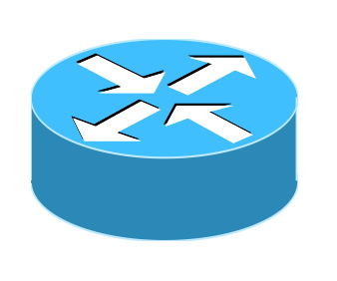
Centralized Solution
Openflow
Policies
Controller
Control plane
Control plane
Data plane
Data plane
Control plane
Data plane

Slide 15
Generalized Forwarding and SDN
Each router contains a flow table that is computed and distributed by a logically centralized routing controller
logically-centralized routing controller
control plane
data plane
local flow table
headers counters actions
1
0100 1101
3
2
values in arriving
packet’s header

Slide 16
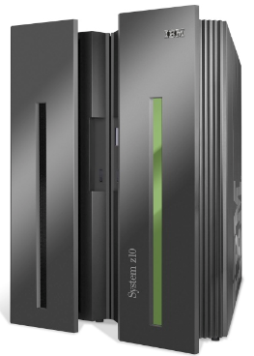

Analogy: mainframe to PC evolution*
App
App
App
App
App
App
App
App
App
App
App
Specialized
Applications
Open Interface
Specialized
Operating
System
Windows
(OS)
Linux
Mac
OS
or
or
Specialized
Hardware
Open Interface
Microprocessor
Vertically integrated
Closed, proprietary
Slow innovation
Small industry
Horizontal
Open interfaces
Rapid innovation
Huge industry
* Slide courtesy: N. McKeown

Slide 17
SDN perspective: data plane switches
Data plane switches
fast, simple, commodity switches implementing generalized data-plane forwarding in hardware
API for table-based switch control (e.g., OpenFlow)
defines what is controllable and what is not
protocol for communicating with controller (e.g., OpenFlow)
network-control applications
…
routing
access
control
load
balance
control
plane
northbound API
SDN Controller
(network operating system)
southbound API
data
plane
SDN-controlled switches

Slide 18
SDN perspective: SDN controller
SDN controller (network OS):
maintain network state information
interacts with network control applications “above” via northbound API
interacts with network switches “below” via southbound API
implemented as distributed system for performance, scalability, fault-tolerance, robustness
network-control applications
…
routing
access
control
load
balance
control
plane
northbound API
SDN Controller
(network operating system)
southbound API
data
plane
SDN-controlled switches

Slide 19
SDN perspective: control applications
network-control apps:
“brains” of control: implement control functions using lower-level services, API provided by SND controller
unbundled: can be provided by 3rd party: distinct from routing vendor, or SDN controller
network-control applications
…
routing
access
control
load
balance
control
plane
northbound API
SDN Controller
(network operating system)
southbound API
data
plane
SDN-controlled switches

Slide 20

OpenFlow
Developed in Stanford
Standardized by Open Networking Foundation (ONF)
Current Version 1.4
Version implemented by switch vendors: 1.3
Allows control of underlay + overlay
Overlay switches: OpenVSwitch/Indigo-light
PC

Slide 21


OpenFlow Switching
Controller
OpenFlow Switch
OpenFlow Switch specification
OpenFlow
Protocol
PC
SSL
Secure
Channel
sw
Flow
Table
hw

Slide 22
Background: Switch Internals
Logical View of a Switch
Physical Architecture of a Switch
Processor
control plane
data plane
ASIC
Switching
Fabric
AISC
Applications
Applications
Network O.S.
ASIC

Slide 23
Software Defined Networking
Current Switch
Vertical stack
Applications
Applications
Applications
Network O.S.
Applications
Applications
SDN
Network O.S.
Southbound
API
ASIC
SDN Switch
Decoupled stack
Switch Operating System
Switch Hardware
Southbound API: decouples the switch hardware from control function
Data plane from control plane
Switch Operating System: exposes switch hardware primitives

Slide 24
Implications Of SDN
Current Networking
SDN Enabled Environment
Applications
Applications
Applications
Applications
Applications
Applications
Applications
Network O.S.
Network O.S.
Global View
ASIC
ASIC
Controller (N. O.S.)
Applications
Applications
Network O.S.
Programmatic
Control
Southbound
API
ASIC
Switch O.S
Switch HW
Switch O.S
Switch O.S
Switch HW
Switch HW

Slide 25
Implications Of SDN
Current Networking
SDN Enabled Environment
Applications
Applications
Applications
Applications
Applications
Applications
Applications
Network O.S.
Network O.S.
Controller (N. O.S.)
ASIC
ASIC
Southbound
API
Switch O.S
Applications
Switch HW
Applications
Network O.S.
Switch O.S
Switch O.S
Switch HW
Switch HW
ASIC
Distributed protocols
Each switch has a brain
Hard to achieve optimal solution
Network configured indirectly
Configure protocols
Hope protocols converge
Global view of the network
Applications can achieve optimal
Southbound API gives fine grained control over switch
Network configured directly
Allows automation
Allows definition of new interfaces

Slide 26
How to Pick an SDN Environment
Applications
Applications
How easy is it to develop on for the
Controller platform?
Applications
Network O.S.
SDN
What is the Southbound AP!?
Southbound
API
Switch Operating System
Is the switch virtual or physical?
Switch Hardware
Is the switch hardware and OS closed?

Slide 27
The SDN Stack
oftrace
oflops
openseer
Monitoring/ debugging tools
ENVI (GUI)
LAVI
n-Casting
…
Applications
NOX
OpenDaylight
ONOS
FloodLight
…
Controller
Slicing
Software
FlowVisor
Console
FlowVisor
Commercial Switches
Software
Ref. Switch
NetFPGA
Broadcom
Ref. Switch
HP, IBM, NEC, Pronto, Juniper.. and many more
OpenFlow
Switches
OpenWRT
PCEngine WiFi AP
Open vSwitch
Source: SDN Tutorial by B. Heller
Open Networking Summit, April 2012
27
Notes:
There are components at different levels that work together in making it work

Slide 28
Server room
OpenFlow
Access Point
OpenFlow
Controller
PC
OpenFlow-enabled
Commercial Switch
OpenFlow
OpenFlow
Normal
Software
Secure
Channel
Normal
Datapath
Flow
Table

Slide 29
How SDN Works: OpenFlow
Applications
Applications
Applications
Controller (N. O.S.)
OpenFlow
OpenFlow
Southbound
API
Switch O.S
Switch O.S
Switch H.W
Switch H.W

Slide 30
OpenFlow data plane abstraction
flow: defined by header fields
generalized forwarding: simple packet-handling rules
Pattern: match values in packet header fields
Actions: for matched packet: drop, forward, modify, matched packet or send matched packet to controller
Priority: disambiguate overlapping patterns
Counters: #bytes and #packets
Flow table in a router (computed and distributed by controller) define router’s match+action rules

Slide 31
OpenFlow data plane abstraction
flow: defined by header fields
generalized forwarding: simple packet-handling rules
Pattern: match values in packet header fields
Actions: for matched packet: drop, forward, modify, matched packet or send matched packet to controller
Priority: disambiguate overlapping patterns
Counters: #bytes and #packets
* : wildcard(萬用字元)
src=1.2.*.*, dest=3.4.5.* → drop
src = *.*.*.*, dest=3.4.*.* → forward(2)
3. src=10.1.2.3, dest=*.*.*.* → send to controller

Slide 32
OpenFlow: Anatomy of a Flow Table Entry
Match
Action
Counter
Priority
Time-out
When to delete the entry
What order to process the rule
# of Packet/Bytes processed by the rule
Forward packet to zero or more ports
Encapsulate(封裝) and forward to controller
Send to normal processing pipeline
Modify Fields
Switch
Port
VLAN
ID
VLAN
pcp
MAC
src
MAC
dst
Eth
type
IP
Src
IP
Dst
IP
ToS
IP
Prot
L4
sport
L4
dport

Slide 33
Examples
Destination-based forwarding:
Switch
Port
MAC
src
MAC
dst
Eth
type
VLAN
ID
IP
Src
IP
Dst
IP
Prot
TCP
sport
TCP
dport
Action
*
*
*
*
*
*
51.6.0.8
*
*
*
port6
IP datagrams destined to IP address 51.6.0.8 should be forwarded to router output port 6
Firewall:
Switch
Port
MAC
src
MAC
dst
Eth
type
VLAN
ID
IP
Src
IP
Dst
IP
Prot
TCP
sport
TCP
dport
Forward
*
*
*
*
*
*
*
*
*
22
drop
do not forward (block) all datagrams destined to TCP port 22
Switch
Port
MAC
src
MAC
dst
Eth
type
VLAN
ID
IP
Src
IP
Dst
IP
Prot
TCP
sport
TCP
dport
Forward
*
*
*
*
*
128.119.1.1
*
*
*
*
drop
do not forward (block) all datagrams sent by host 128.119.1.1

Slide 34
Examples
Destination-based layer 2 (switch) forwarding:
Switch
Port
MAC
src
MAC
dst
Eth
type
VLAN
ID
IP
Src
IP
Dst
IP
Prot
TCP
sport
TCP
dport
Action
*
22:A7:23:
11:E1:02
*
*
*
*
*
*
*
*
port3
layer 2 frames from MAC address 22:A7:23:11:E1:02 should be forwarded to output port 6

Slide 35
OpenFlow: Types of Messages
Asynchronous (Controller-to-Switch) 非同步
Send-packet: to send packet out of a specific port on a switch
Flow-mod: to add/delete/modify flows in the flow table
Asynchronous (initiated by the controller)
Read-state: to collect statistics about flow table, ports and individual flows
Features: sent by controller when a switch connects to find out the features supported by a switch
Configuration(組態): to set and query configuration parameters in the switch
Asynchronous (initiated by the switch)
Packet-in: for all packets that do not have a matching rule, this event is sent to controller
Flow-removed: whenever a flow rule expires, the controller is sent a flow-removed message
Port-status: whenever a port configuration or state changes, a message is sent to controller
Error: error messages
Symmetric (can be sent in either direction without solicitation)
Hello: at connection startup
Echo: to indicate latency, bandwidth or liveliness of a controller-switch connection
Vendor: for extensions (that can be included in later OpenFlow versions)

Slide 36
Dimension of SDN Applications: Rule installation
Proactive(主動) Rules
Reactive Rules
Applications
Applications
Applications
Applications
Applications
Applications
Controller (N. O.S.)
Controller (N. O.S.)
O.S
O.S
Switch H.W
Switch H.W

Slide 37
Dimension of SDN Applications: Rule installation
Proactive Rules
Reactive Rules
Controller pre-installs flow table entries
Zero flow setup time
Requires installation of rules for all possible traffic patterns
Requires use of aggregate rules (Wildcards)
Require foreknowledge of traffic patterns
Waste flow table entries
First packet of each flow triggers rule insertion by the controller
Each flow incurs flow setup time
Controller is bottleneck
Efficient use of flow tables

Slide 38
Dimensions of SDN Applications: Granularity of Rules
Microflow
WildCards (aggregated rules)
Applications
Applications
Applications
Applications
Applications
Applications
Controller (N. O.S.)
Controller (N. O.S.)
O.S
O.S
Switch H.W
Switch H.W

Slide 39
Dimensions of SDN Applications: Granularity of Rules
Microflow
WildCards (aggregated rules)
One flow table matches one flow
Uses CAM/hash-table
10-20K per physical switch
Allows precisions
Monitoring: gives counters for individual flows
Access-Control: allow/deny individual flows
One flow table entry matches a group of flow
Uses TCAM
5000~4K per physical switch
Allows scale
Minimizes overhead by grouping flows

Slide 40
Dimensions of SDN Applications: Granularity of Rules
Distributed Controller
Centralized Controller
Applications
Applications
Applications
Applications
Applications
Applications
Controller (N. O.S.)
Controller (N. O.S.)
Applications
Applications
Applications
Applications
Applications
Applications
Switch O.S
Switch HW
Controller (N. O.S.)
Controller (N. O.S.)
Switch O.S
Switch O.S
Switch HW
Switch HW
Switch O.S
Switch HW
Switch O.S
Switch O.S
Switch HW
Switch HW

Slide 41
Google’ B4 Application
Rule installation
Proactive
Rule Granularity
Aggregate
Distributed
Multiple instances

Slide 42
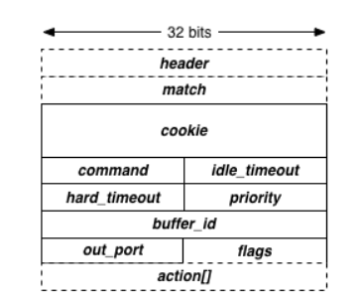
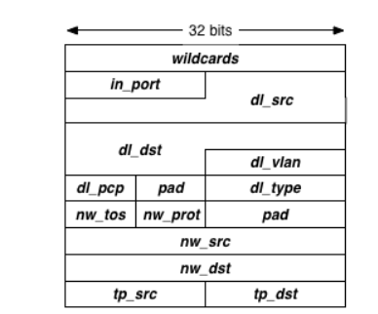
OpenFlow: Message Formats
Controller encapsulates message into an object
Accessor functions to different fields
No need to worry about crafting network packets

Slide 43
OpenFlow Actions (Partial list from OpenFlow 1.0 spec)
Output to switch port (Physical ports & virtual ports). Virtual ports include the following:
ALL (all standard ports excluding the ingress port) - flood
CONTROLLER (encapsulate and send the packet to controller) – PACKET_IN message
LOCAL (switch’s stack) – go through the IP layer, etc (mostly used for vSwitches)
NORMAL (process the packet using traditional non-OpenFlow pipeline of the switch) – traditional L2 forwarding, L3 routing
Drop
Set fields (packet modification/header rewriting)
Ethernet Source address
Ethernet Dest address
IP source & dest addresses, IP ToS(type of service), IP ECN, IP TTL, VLAN
TCP/UDP source and destination ports
Strip (pop) the outer VLAN tag
Set queue ID when outputting to a port (Enqueue)
New in OpenFlow 1.1+
Support for matching across multiple tables
Support for tunneling
Support for Push/Pop mulitple VLAN/MPLS/PBB tags

Slide 44
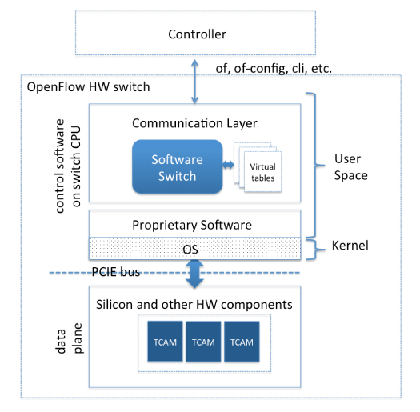
Flow Tables
There are two layers of flow tables

Slide 45
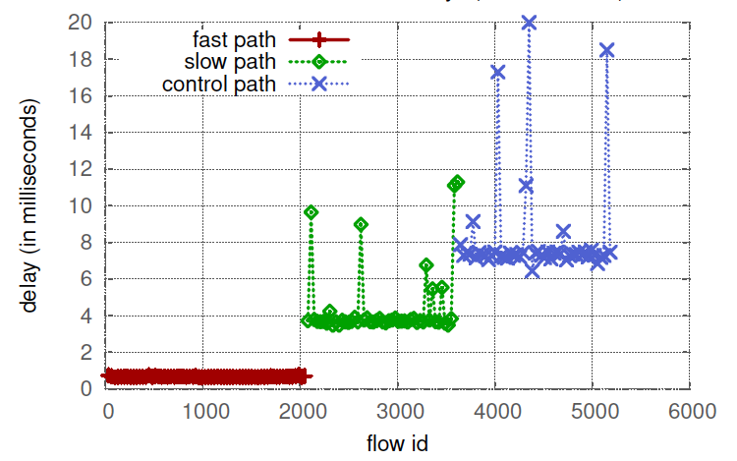
Forwarding Delay
“Tango: Simplifying SDN Control with Automatic Switch Property Inference, Abstraction, and Optimization”, Aggelos Lazaris, Daniel Tahara, Xin Huang, Li Erran Li, Andreas Voellmy, Y. Richard Yang, and Minlan Yu, CoNEXT’14
Fast path delay: 0.665 ms
Slow path delay: 3.7 ms
Control path delay: 7.5 ms

Slide 46
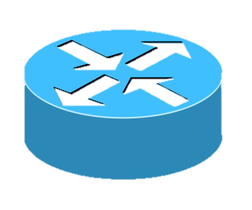
Topology Discovery
An OpenFlow controller discover topology by sending LLDP control messages
The controller discover the neighbor of a switch based on where packet-in comes from
Controller
Link Layer Discovery Protocol
Packet-in LLDP
Packet-in LLDP
Packet-out LLDP
Switch 2
Switch 1
Switch 3

Slide 47
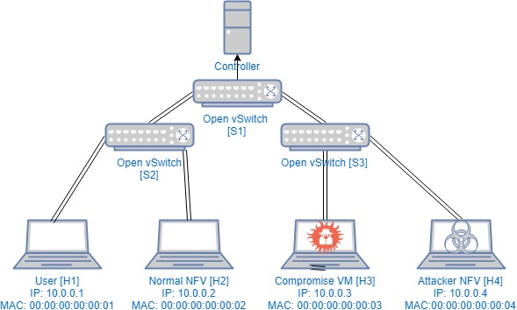
Host Tracking
Host location information
Switch tells controller the host location when the host sends any data packet
Data Packets

